Slide 1
GADM IDs for levels 0-2
GID_0 | NAME_0
ABW | Aruba
AFG | Afghanistan
AGO | Angola
AIA | Anguilla
ALA | Åland
ALB | Albania
AND | Andorra
ARE | United Arab Emirates
ARG | Argentina
ARM | Armenia
ASM | American Samoa
ATA | Antarctica
GID_1 | NAME_1
AFG.10_1 | Ghor
AFG.11_1 | Hilmand
AFG.12_1 | Hirat
AFG.13_1 | Jawzjan
AFG.14_1 | Kabul
AFG.15_1 | Kandahar
AFG.16_1 | Kapisa
AFG.17_1 | Khost
AFG.18_1 | Kunar
AFG.19_1 | Kunduz
AFG.1_1 | Badakhshan
AFG.20_1 | Laghman
GID_2 | NAME_2
AFG.1.10_1 | Shahri Buzurg
AFG.1.11_1 | Shighnan
AFG.1.12_1 | Wakhan
AFG.1.13_1 | Zebak
AFG.1.1_1 | Baharak
AFG.1.2_1 | Darwaz
AFG.1.3_1 | Fayzabad
AFG.1.4_1 | Ishkashim
AFG.1.5_1 | Jurm
AFG.1.6_1 | Khwahan
AFG.1.7_1 | Kishim
AFG.1.8_1 | Kuran Wa Munjan

Slide 2
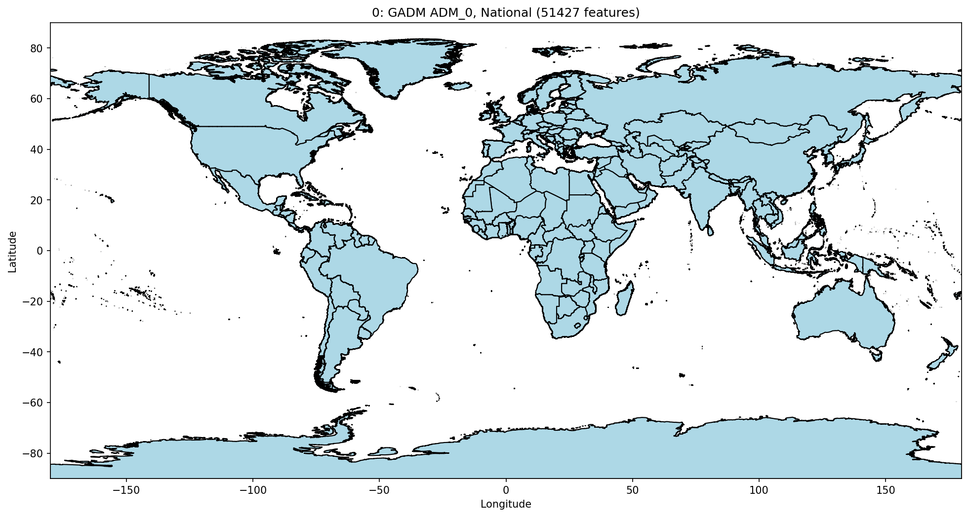

Slide 3
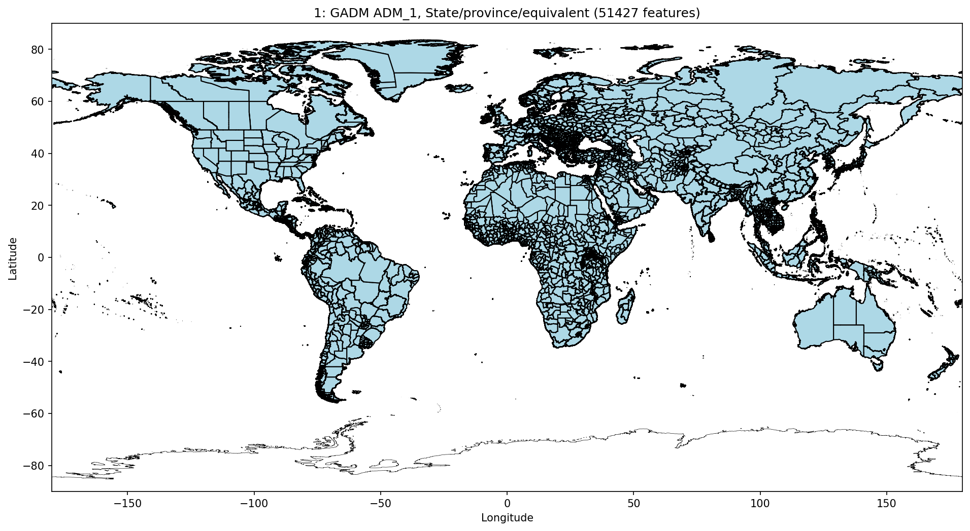

Slide 4
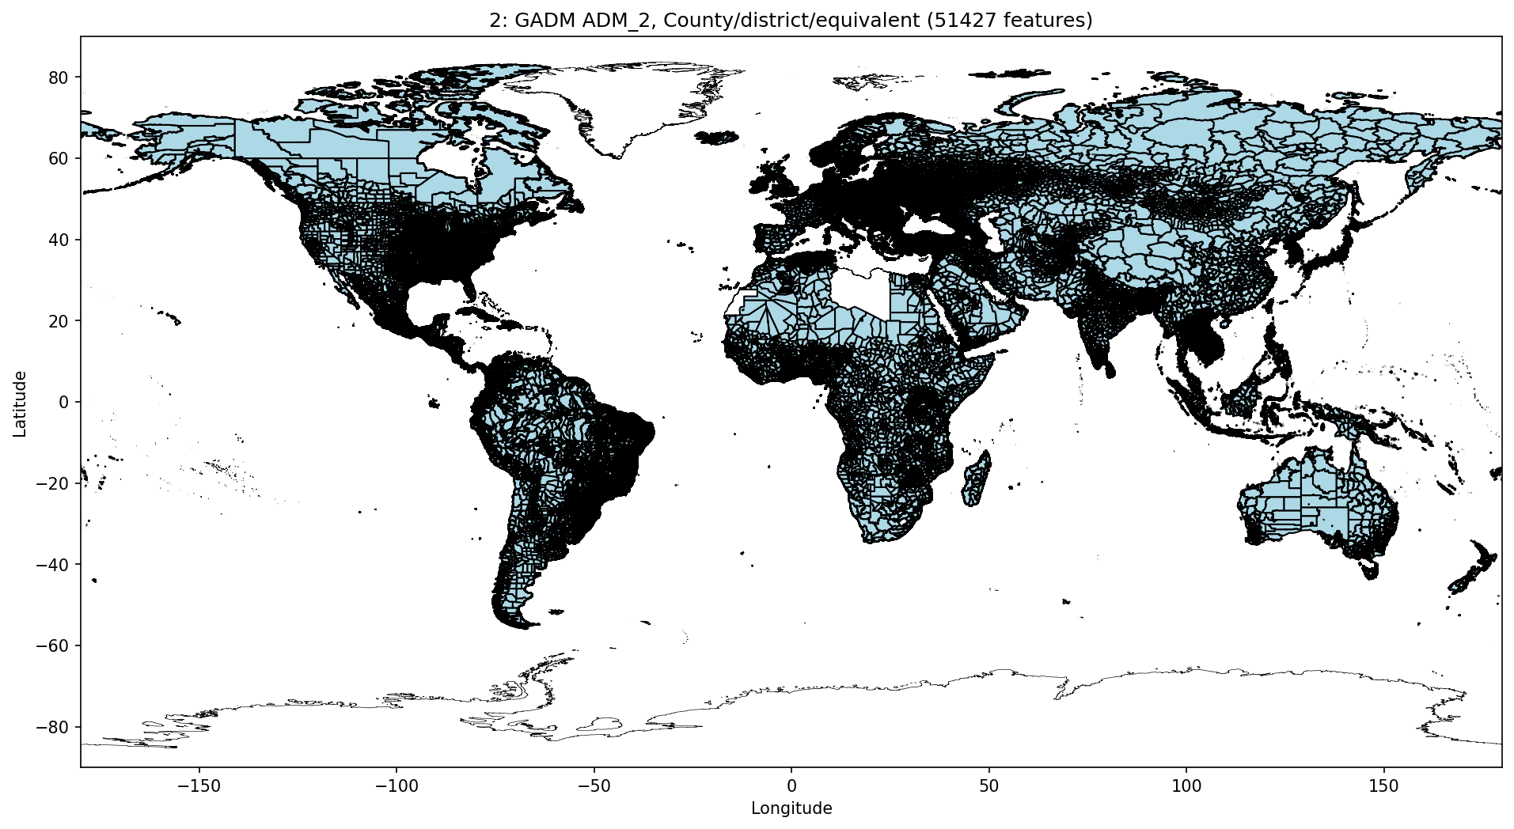

Slide 5
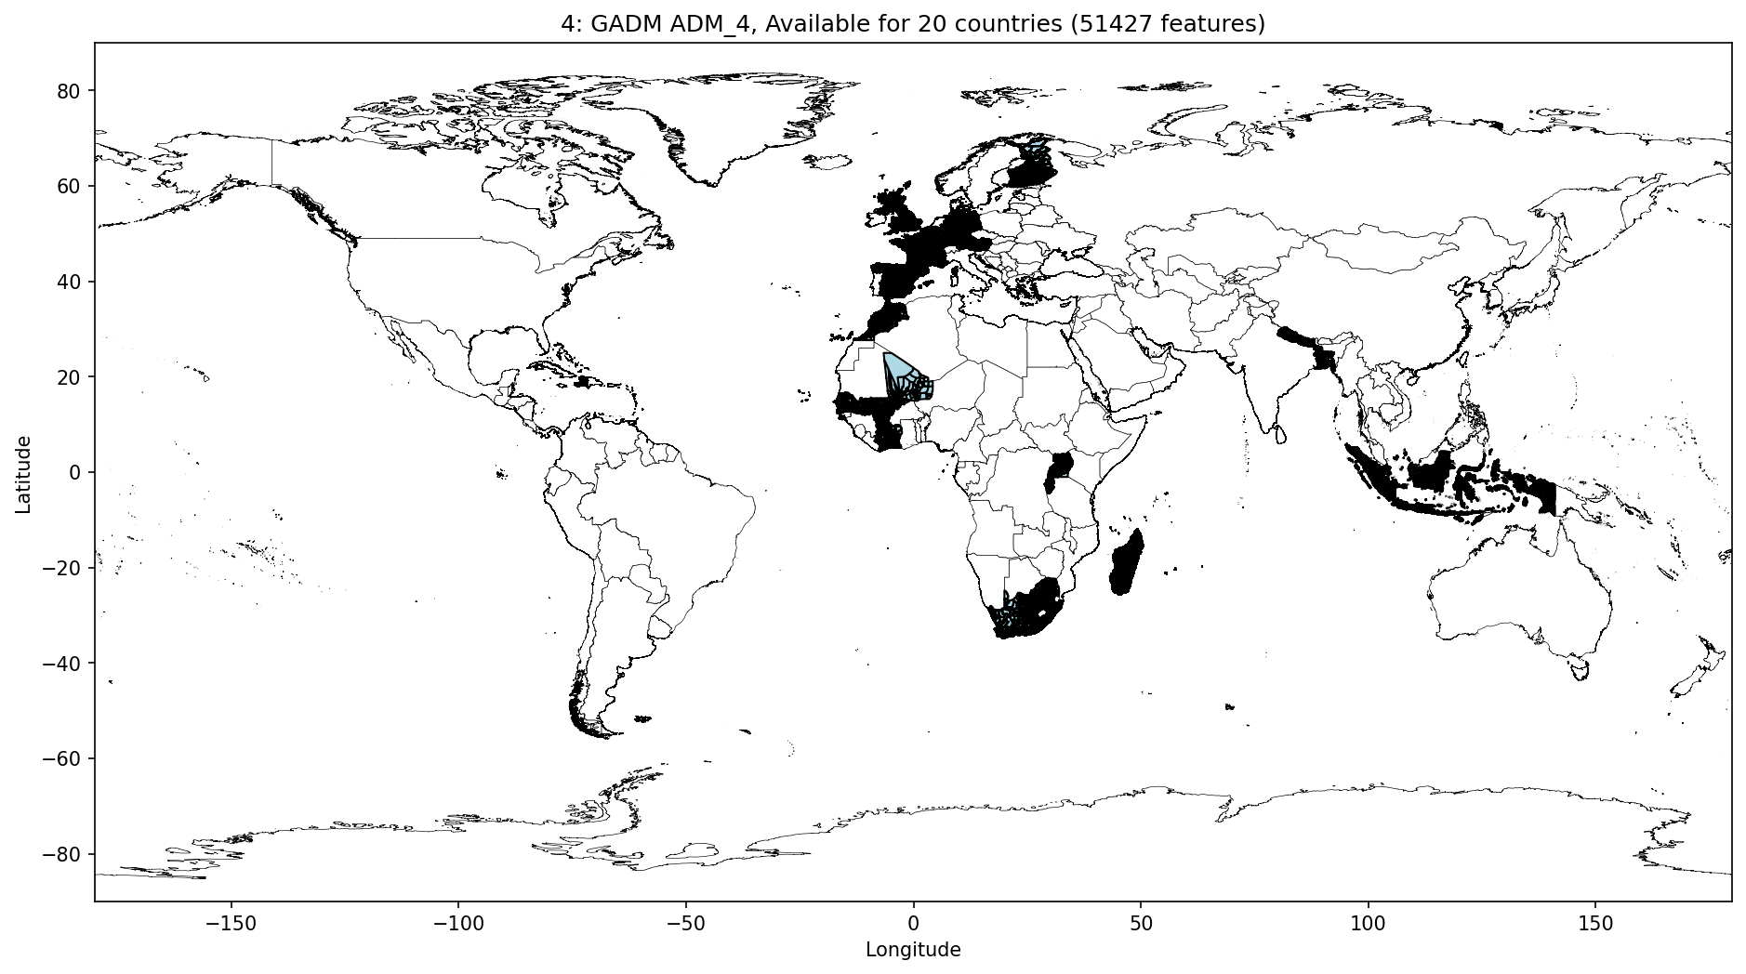

Slide 6
